Slide 1
HR Dashboard Project
Gobinath subramani | Rev4

Slide 2
HR Dashboard Software
An HR dashboard is an advanced analytics tool that displays important HR metrics using interactive data visualizations. It helps the HR department to improve recruiting processes, optimize the workplace management as well as to enhance the overall employee performance. Just like so many of today’s business departments, human resources is slowly but surely evolving into a data-driven function. Filled with numerous HR KPIs, the purpose is to go from simple reporting to smarter use of analytics, enabling companies and managers to track and predict employees’ performance, make better-informed talent decisions, and have the opportunity to operate advanced workforce planning with the help of modern HR analytics software. Turning to a professional online dashboard, HR professionals can keep a close eye on employee performance, recruiting, and talent management processes.

Slide 3
Scope of HR dashboard
HR dashboards are useful for analysing performance and identifying areas for improvement in an organization. They’re not only important to HR managers, but for executives as well. Decision makers ensure that company strategy is aligned from executive to managerial to individual goals. Executives and HR leaders must work together to identify the data they need in order to take action. Then you can collect and monitor that data to keep workforce performance aligned with organizational objectives.
Notes:
May require more than one slide

Slide 4
Technologies used
In this project I have made an attempt to create a HR dashboard in Python using dash library to get summary numbers for an imaginary organization. The required python packages are
dash==1.2.0
dash_table==4.2.0
pandas==0.24.2
numpy==1.16.2
The HR dashboard that showed information about recruiting sources, active employees, attrition rates, and many more. With Plotly and Dash, I experimented with chained callbacks to allow for more variety of dashboard filter options.

Slide 5
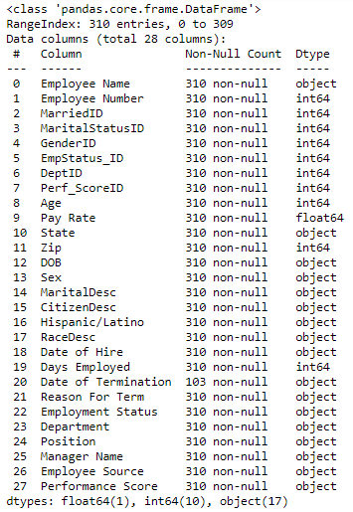
Data set
The data set contains the below data points with the shape of 28 columns & 310 rows of data.

Slide 6
Dashboard information:
The Dashboard four different taps
Head Count & Attrition
Diversity Profile
Recruitment
Data Table

Slide 7
Head Count & Attrition
Many companies make significant investments when hiring new employees- There are recruiting costs, training costs, salary, benefits – and the list goes on. In addition, it could take a while until companies start seeing a return on their investment. Hence, companies are constantly looking for ways to reduce employee turnover rate and to prevent valued employees from leaving the company. This tap contains the information of following data points.
Notes:
May require more than one slide

Slide 8
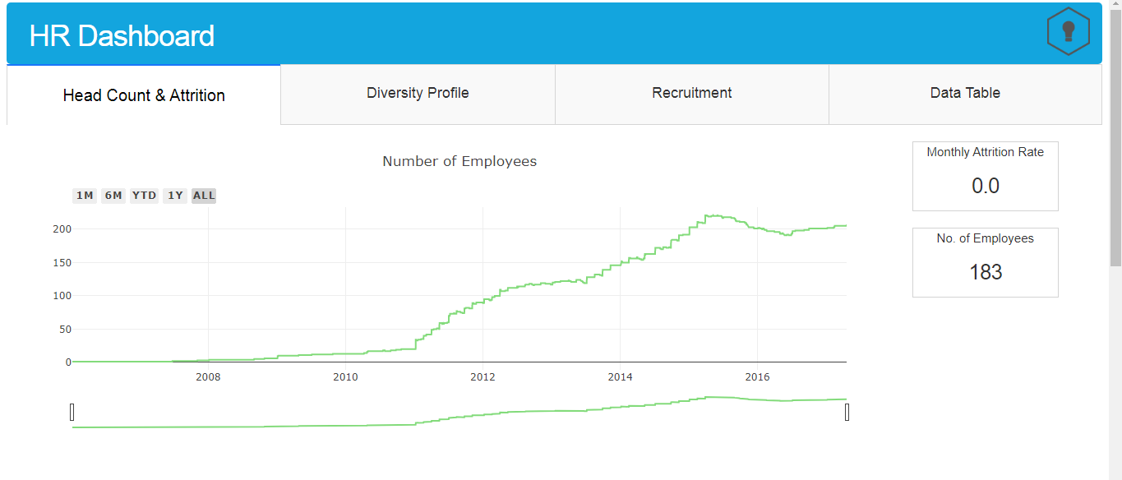
Head Count & Attrition
Number of employees (It can be viewed by monthly & yearly wise options)
Notes:
May require more than one slide

Slide 9
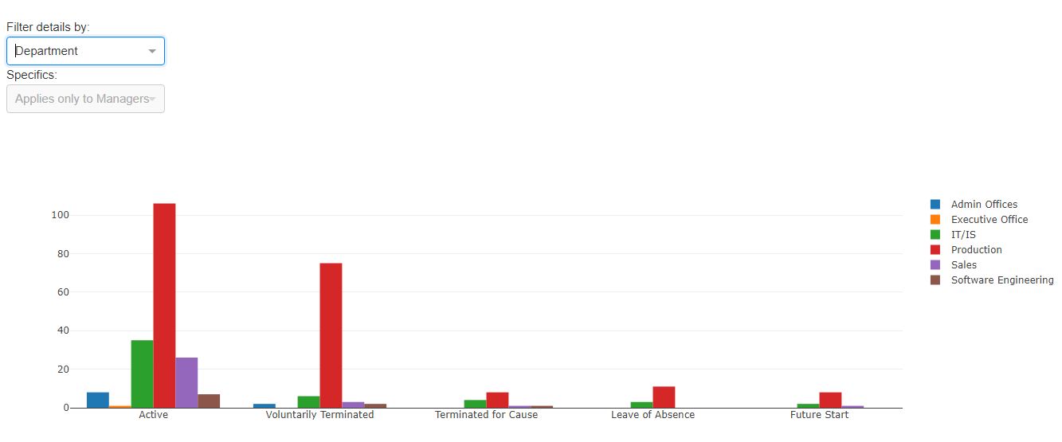
Head Count & Attrition
Attrition rate (Filter by: Department wise)
Notes:
May require more than one slide

Slide 10
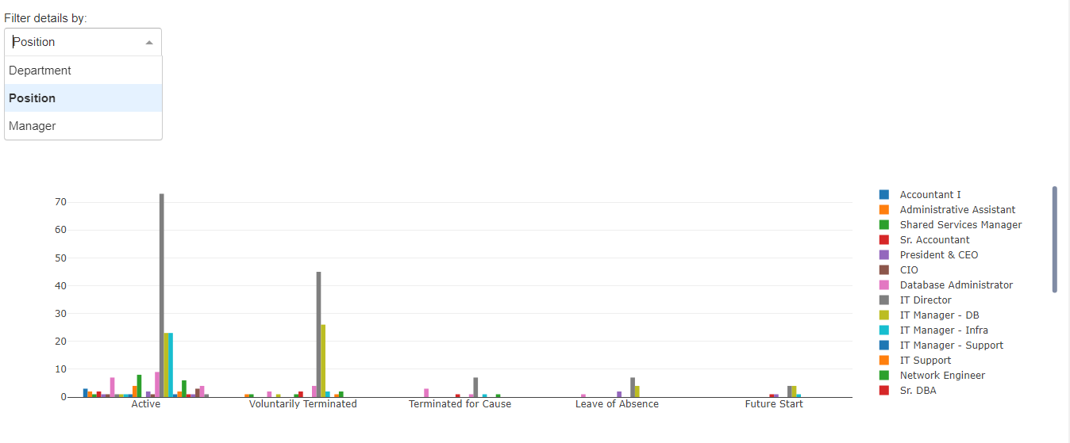
Head Count & Attrition
Attrition rate (Filter by: Position wise)
Notes:
May require more than one slide

Slide 11
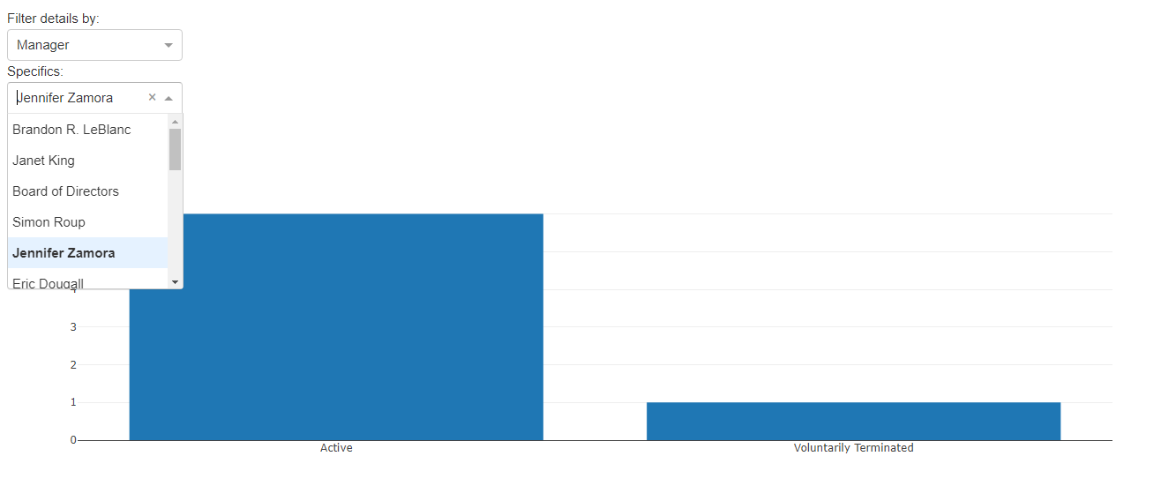
Head Count & Attrition
Attrition rate (Filter by: Manager wise)
Notes:
May require more than one slide

Slide 12
Diversity Profile
It’s easy to say that your company is diversified and inclusive. With the recent news of numerous employee diversity and inclusion issues in a lot of industries, companies are becoming increasingly aware of their activities when it comes to hiring. This tap contains the information of following data points.
Notes:
May require more than one slide

Slide 13
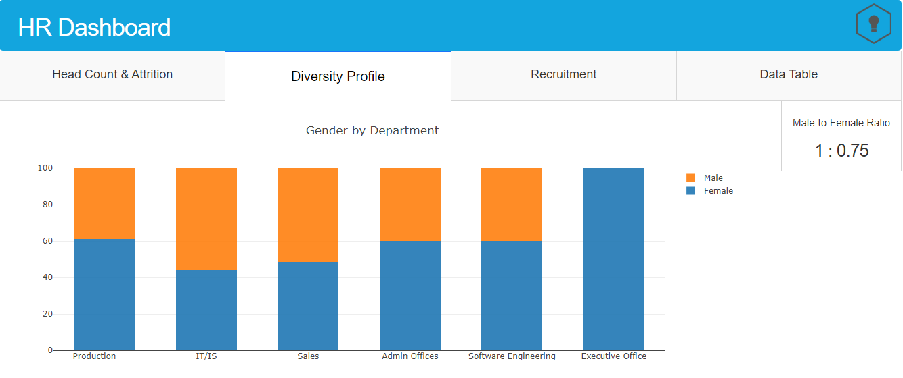
Diversity Profile
Gender by department
Notes:
May require more than one slide

Slide 14
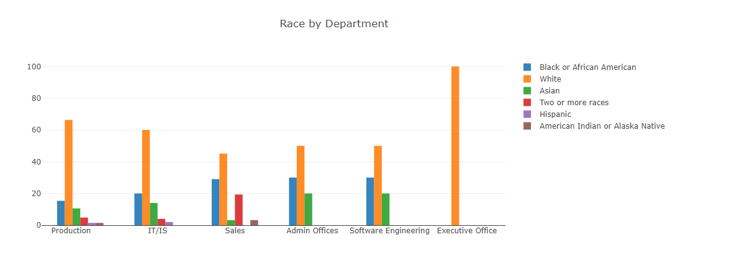
Diversity Profile
Race by department
Notes:
May require more than one slide

Slide 15
Recruitment
Measuring the hiring process can contribute to organizational efforts to reduce the above by getting insights into the process. This will allow the organization to identify areas that it needs to improve\maintain\develop and take action accordingly. This BI solution is meant to identify bottlenecks and opportunities in the hiring process in order to improve efficiency, avoid lost revenue and additional costs by reducing the time it takes for the organization to hire new employees. This tap contains the information of below data points.
Notes:
May require more than one slide

Slide 16
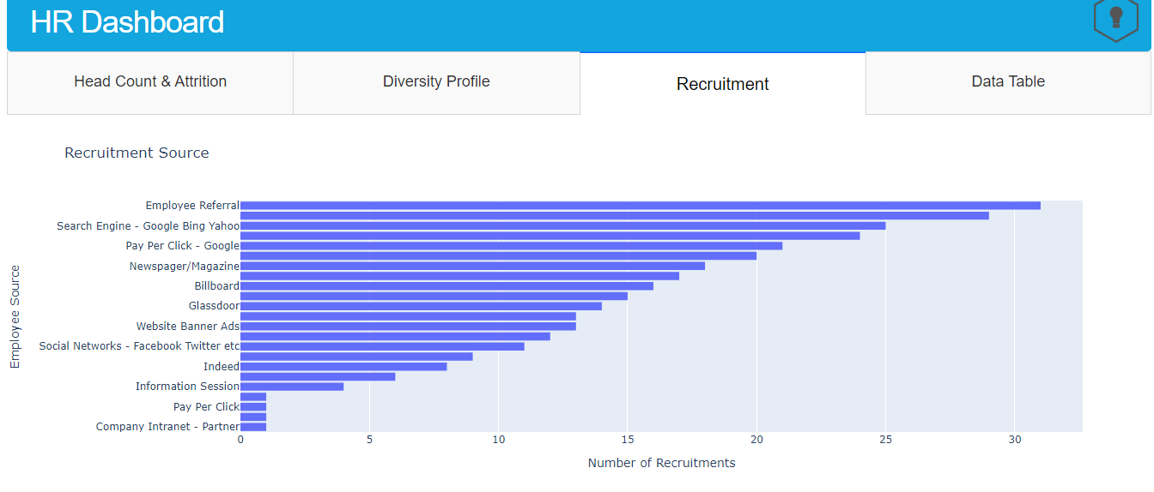
Recruitment
Recruitment source
Notes:
May require more than one slide

Slide 17
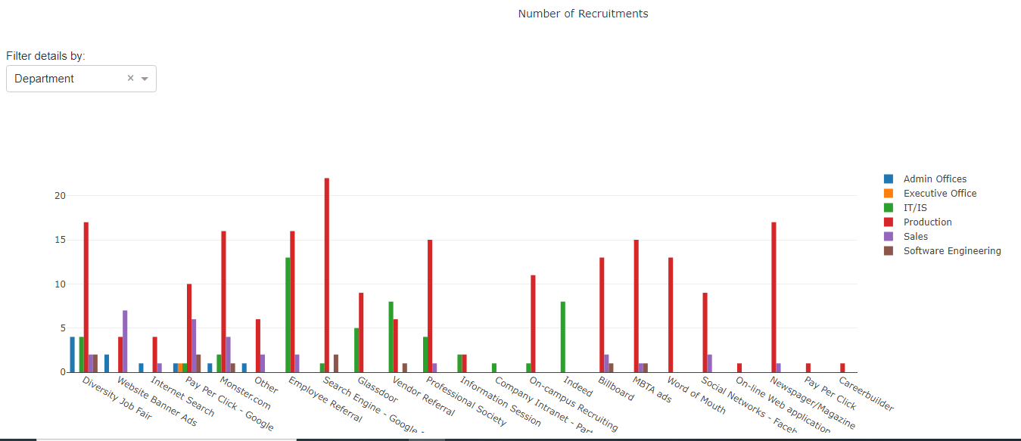
Recruitment
Recruitment source by department
Notes:
May require more than one slide

Slide 18
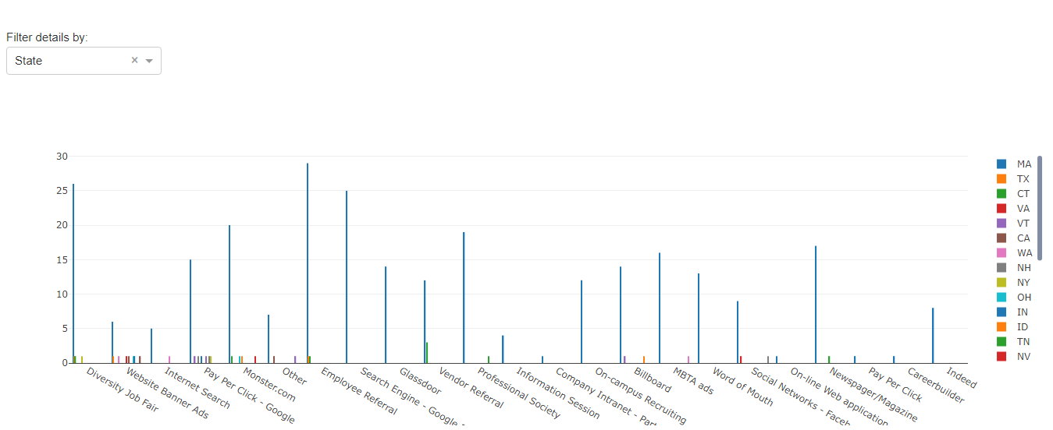
Recruitment
Recruitment source by State
Notes:
May require more than one slide

Slide 19
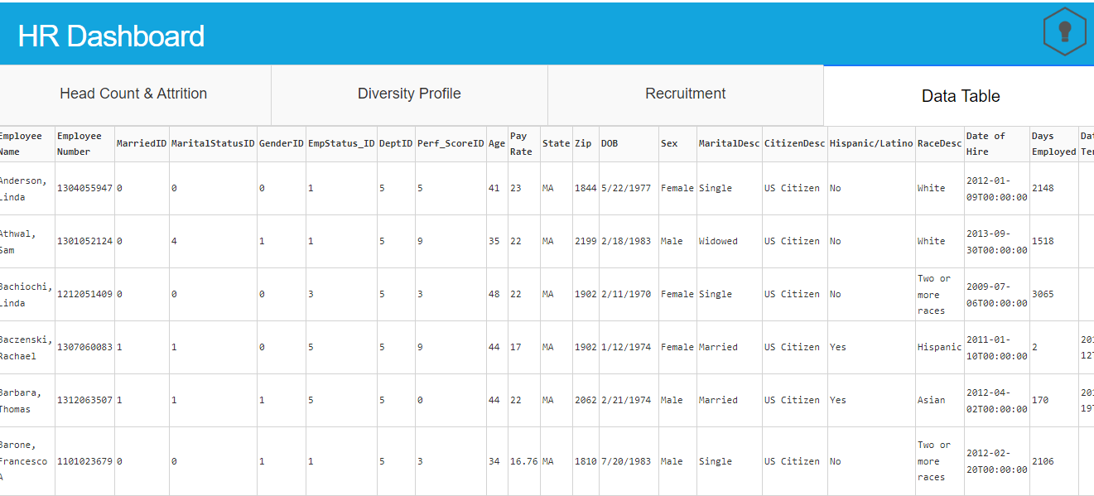
Data Table
In this tap you can view the dataset we used for the dashboard creation.
Notes:
May require more than one slide

Slide 20
Data visualization features
In this dashboard every chart having the different features to see the chart.
The features are
Download plot as PNG image format
Zoom in & out
Pan
Box Select
Auto scale
Reset Axes
Show the closest data on hover
Compare the data on hover
Notes:
May require more than one slide

Slide 21
Benefits of Dashboard for HR Teams
HR Monitoring
An automated HR dashboard enables the HR to keep a close view on the key aspects of an organization by tracking workforce metrics. S/he can track emerging trends, opportunities and well as potential problems so that they can be addressed in advance.
Employee Retention
With the metrics and reports, the user can track key problems in an effective and transparent way. The HR and managers can concentrate on driving improvements without losing any star employee of the business organization.
Management Information
The user can now easily inform the concerned team officials and managers about any relevant information or developments in their teams and departments. In this way, the HR will help the manager in his job by making him/her aware of the all necessary data or information.
Notes:
May require more than one slide

Slide 22
Benefits of Dashboard for HR Teams
Data Delivery
An automated dashboard allows the HR to gather any relevant information from the employee, structure it and deliver it to the concerned teams in the business organization. This reduces the possibility of any mistake which is too common in manual data gathering and presentation.
Trend Analysis
Through this advanced HR technology, the HR team can keep an eye on any specific trend related to business or an employee. If there is an alarming situation, the HR team can notify the concerned team or manager in advance so that it doesn’t hamper the business growth.
Notes:
May require more than one slide

Slide 23
Conclusion
This project has not been deployed yet, so it can only be run locally. The web app will be launched to your localhost on port 8050: http://127.0.0.1:8050 . So the data won’t be shared to outside of organization as per data privacy policy.
Notes:
May require more than one slide

Slide 24

Thank You
Notes:
May require more than one slide

